Slide 1





APK Shield
PS 1: Generative AI-Based Automated Analysis and Risk Scoring of Fraudulent APKs

Slide 2

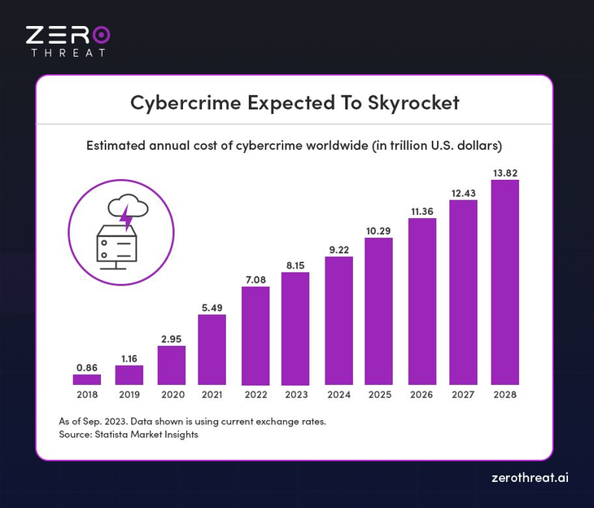
Proposed solution
PROBLEM
📱 Fraudulent APKs Are a Growing Threat
Malicious Android applications are increasingly distributed through WhatsApp, SMS, email, Telegram, and phishing websites to steal banking credentials, OTPs, personal data, and financial information.
🏦 Banks Face Rising Fraud Risks
Detecting malicious APKs requires specialized cybersecurity expertise, reverse engineering skills, and significant investigation time, making large-scale analysis difficult.
⚠️ Current Analysis Methods Are Slow & Expensive
Automated APK Investigation
Uploads suspicious APK files and automatically performs static, dynamic, and AI-driven malware analysis.
APK Shield
DETECT , ANALYSE , PREVENT
Multi-Layer Threat Detection
Uses APK decompilation, permission analysis, API inspection, YARA signatures, VirusTotal intelligence, and runtime monitoring to uncover malicious behavior.
Generative AI Malware Analyst
AI agents act as Code Analysts, Threat Correlators, Malware Classifiers, and Investigation Writers to interpret findings and explain risks in plain English.
Intelligent Risk Scoring
Generates a 0–100 risk score, malware classification, threat severity level, and confidence score for rapid decision-making.
Investigation Reports
Produces detailed PDF/JSON reports containing attack indicators, MITRE ATT&CK mappings, suspicious permissions, network activity, and remediation guidance.
Built For Security Teams
Designed for banks, cybersecurity teams, fraud investigators, CERT teams, and enterprise security operations centers (SOCs).

Slide 3


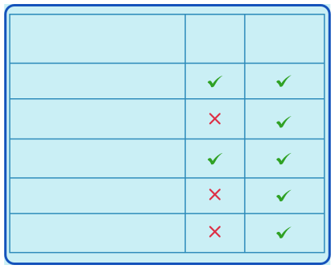

What are we building
Feature
Other Tools
APK SHIELD
Manual Reverse Engineering
We are building an automated system for banks, cybersecurity teams, and fraud investigators, and end users. Users can submit a suspicious Android application (APK file) and receive a full investigation report
Automated Risk Scoring
Generative AI Investigation
Plain-English Reports
Plain-English Reports

Slide 4





How users intereact with the system
There are three seamless submission methods available:
Telegram Bot: This is the primary recommendation because real-world fraud usually begins via SMS or WhatsApp links. Users can simply forward the suspicious message directly to the bot. The system processes it automatically with no manual downloads required.
Web Application: A clean web portal where users can upload APK files or paste links manually. This interface is perfect for live demonstrations and judging sessions.
Desktop Integration: A shortcut that allows a user to right-click any APK file on their computer to start the analysis. The results open automatically in their browser.

Slide 5



User submitted APK file
Stage 0 : Source Verification
Stage 1 : APK Identity Analysis
Stage 2 : Threat Intelligence
Stage 3 : Signature Detection
Stage 4 : Dynamic Analysis
Stage 5 : Report Generation
Domain age check
SSL Verification
Infrastructure scan
Androguard
Permission Check
SHA256 Hash
YARA Rules
Android Emulator
Aggregate Findings
MITRE ATT&CK Mobile
Monkey Testing
VirusTotal Lookup
AI agent 4:
Investigation Writer
JADX Decompiler
Suspicious source?
AI agent 2:
Pattern Corelator
Frida Monitoring
AI agent 1:
Code analyst
Known malware
Final Threat report:
Risk score (0-100)
Malware Family
MITRE Mapping
Recommendations
PDF Export
YES
AI agent 3:
Malware Classifier
High risk?
A banking application hosted on a brand-new domain with an invalid certificate is flagged as highly suspicious immediately
Safe code?
YES
No
report
Continue
YES
No
Cross verification
YARA vs Behavior
YES
No
dynamic
analysis
report
Continue
report

Slide 6
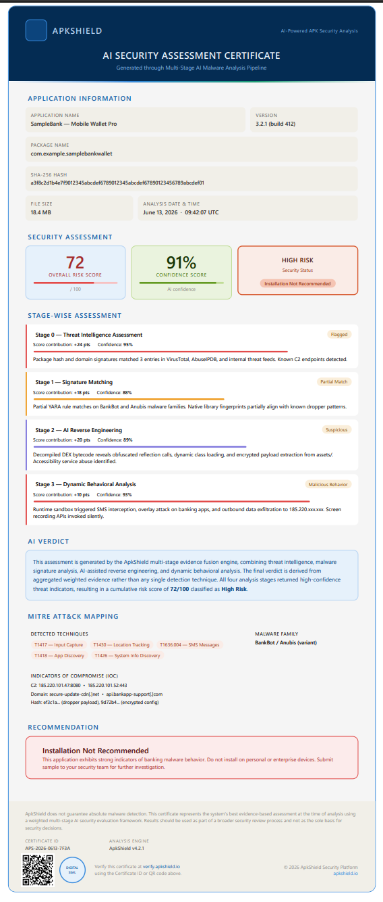



Economic
FEASIBILITY
Open-Source Foundation
Core analysis tools are open-source, reducing development costs.
Reduced Investigation Costs
Cuts manual malware analysis time from hours to minutes.
High Industry Demand
Banks, fintech firms, CERT teams, and cybersecurity companies require rapid threat investigation.
Technical
Existing Security Tools
Built using proven cybersecurity tools:
Androguard, JADX, VirusTotal, YARA, Frida, Android Emulator
No custom malware engine required from scratch.
AI-Powered Analysis
Generative AI interprets decompiled code, permissions, APIs, and runtime behavior.
Automates tasks currently performed by security analysts.
Scalable Architecture
Cloud-based processing for multiple APK submissions.
Modular pipeline allows future expansion to iOS and desktop malware.
Automated Risk Scoring
Combines static analysis, dynamic analysis, threat intelligence, and AI findings into a unified risk score.
VIABILITY
Banks Already Need This
Growing APK-based financial fraud requires faster detection and response.
Technology Is Available Today
All required tools, APIs, and AI models already exist and can be integrated.
Significant Time Savings
Reduces investigation effort from several hours to a few minutes.

Slide 7


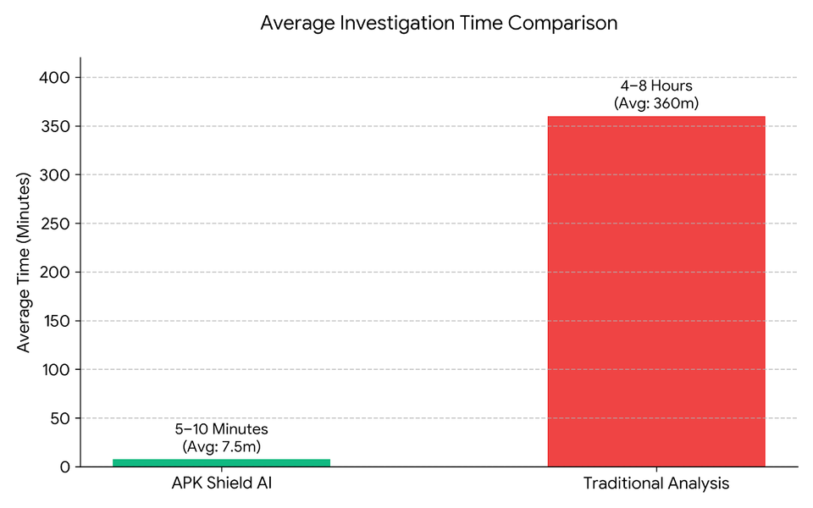
The Core Innovation: AI as an Active Analyst
AI doesn't just summarize — it performs four specialist analyst roles:
Code Analyst reading decompiled Java for hidden theft logic
Pattern Correlator linking clues into an attack story
Independent Behavioral Classifier identifying malware from runtime behavior alone
Investigation Writer producing the final plain-English report

Slide 8








Androguard: Selected because it provides fast, lightweight APK parsing without requiring heavy, complex frameworks.
JADX: Chosen because it produces high-quality, readable Java source code that our AI can easily analyze.
VirusTotal: Selected to instantly screen out known malware variants, saving valuable processing time and computing power.
YARA: Chosen because it is the industry standard for matching code signatures and identifying specific malware families.
Frida: Selected because its real-time API monitoring cannot be easily bypassed by malware that uses code obfuscation.
Android Emulator: Chosen to provide a completely isolated, safe environment to execute and observe untrusted applications.
Gemini: Selected because it offers a generous free tier and easily manages all four highly specialized AI analyst roles.
Streamlit: Chosen because it allows the team to build a clean, professional web dashboard rapidly with minimal code overhead.
Telegram: Selected because it mirrors real-world phishing delivery methods, keeping the user experience relevant to the problem statement.
Tech stack

Slide 9



Implement Stage 0 and Stage 1 first. Focus entirely on downloading the APK, extracting permissions, and decompiling code with JADX.
Phase 1 (Core Pipeline)
Integrate the VirusTotal API lookup and verify that the reputation checks work correctly.
Phase 2 (Threat Intel)
Phased implementation
Phase 3 (Signatures & Logic)
Add YARA rule scanning and build the baseline numeric risk-scoring system.
Connect the Gemini API and implement the four distinct AI analyst prompts and roles.
Phase 4 (AI Integration)
Build the Streamlit web dashboard and the Telegram bot interface to accept submissions.
Phase 5 (User Interfaces)
If development time permits, set up the Android emulator environment, attach Frida instrumentation, and launch the Monkey automation tool.
Phase 6 (Dynamic Analysis)

